Slide 1
DEVELOP A SOFTWARE TO ENHANCE CONTROL FOR PHYSICALLY CHALLENGED INDIVIDUALS IN A SMART HOME ENVIRONMENT.
BY IQRA IQBAL

Slide 2
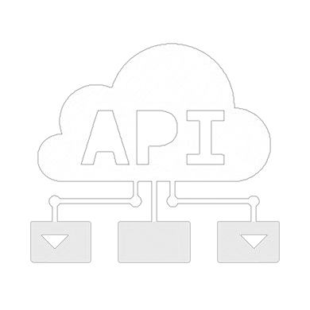
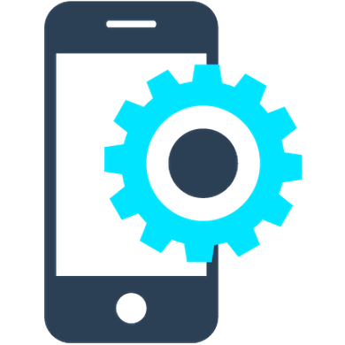
AIMS AND OBJECTIVES
MOBILE APPLICATION
MAIN SYSTEM
API

Slide 3
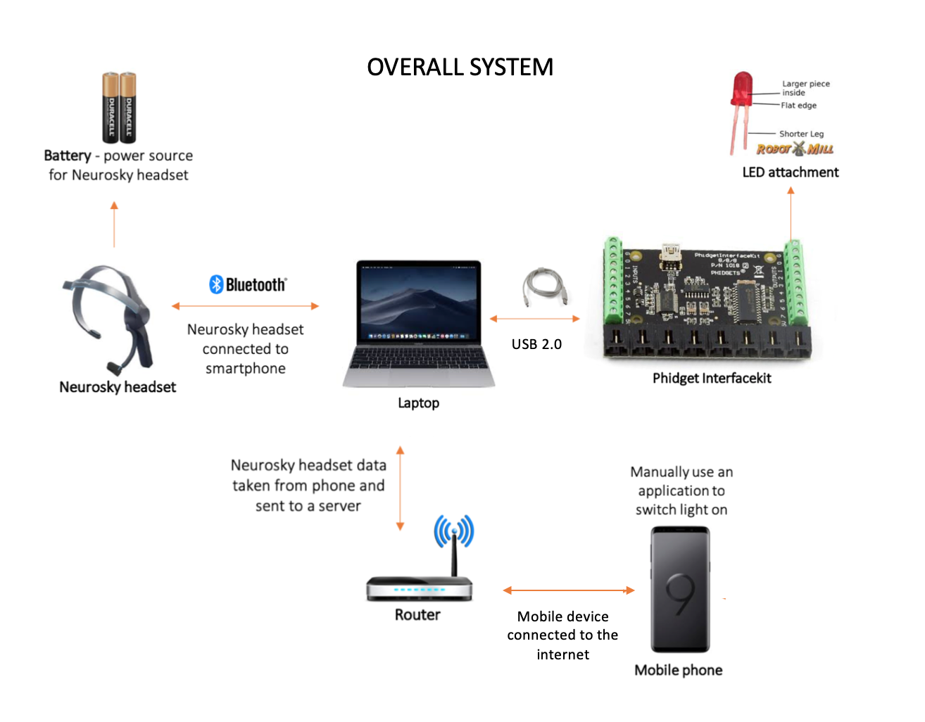
DESIGN
REQUIREMENTS FOR THE SYSTEM
User to NOT physically move to switch on/off the light
Communicate with the light system and ECG headset
System is expandable for further development and enhancement

Slide 5
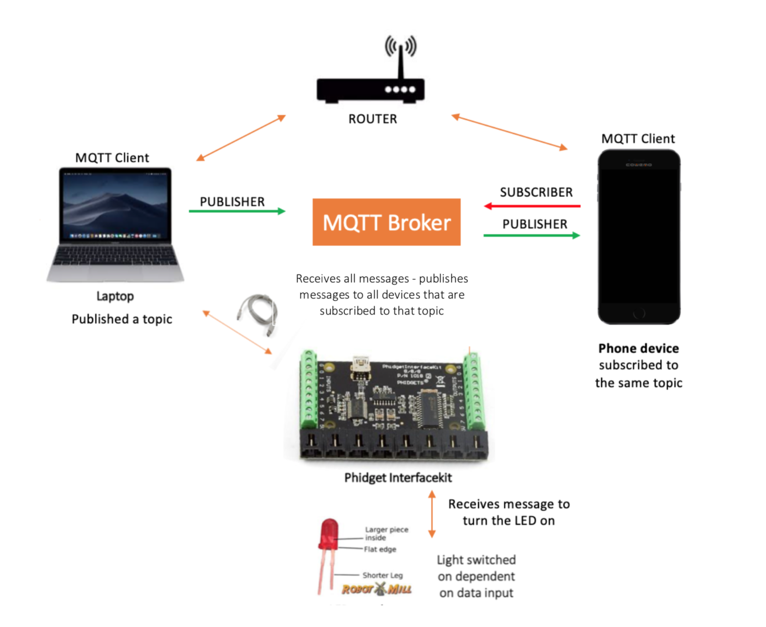
REQUIREMENTS FOR THE MOBILE APPLICATION
An easy, friendly user experience
User able to communicate at any range
Data stored must be secure
MQTT
Data is encrypted – The network uses secure sockets

Slide 6
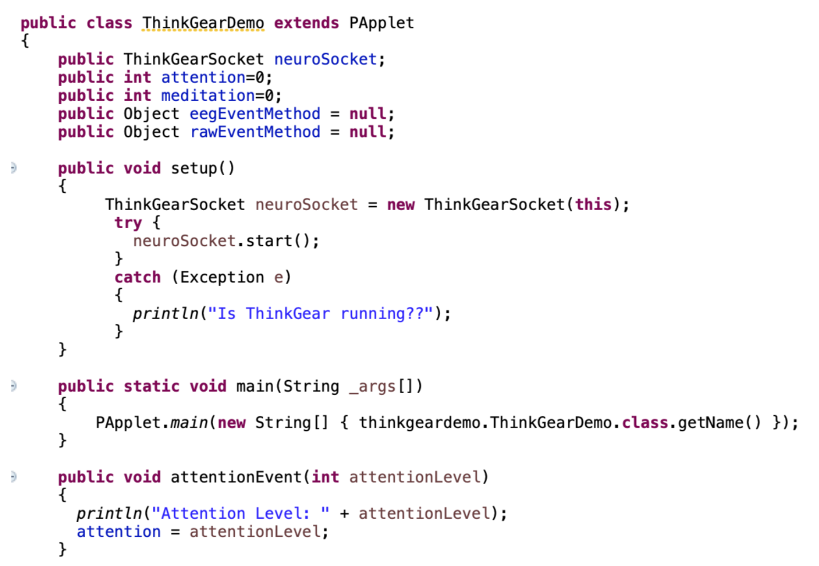
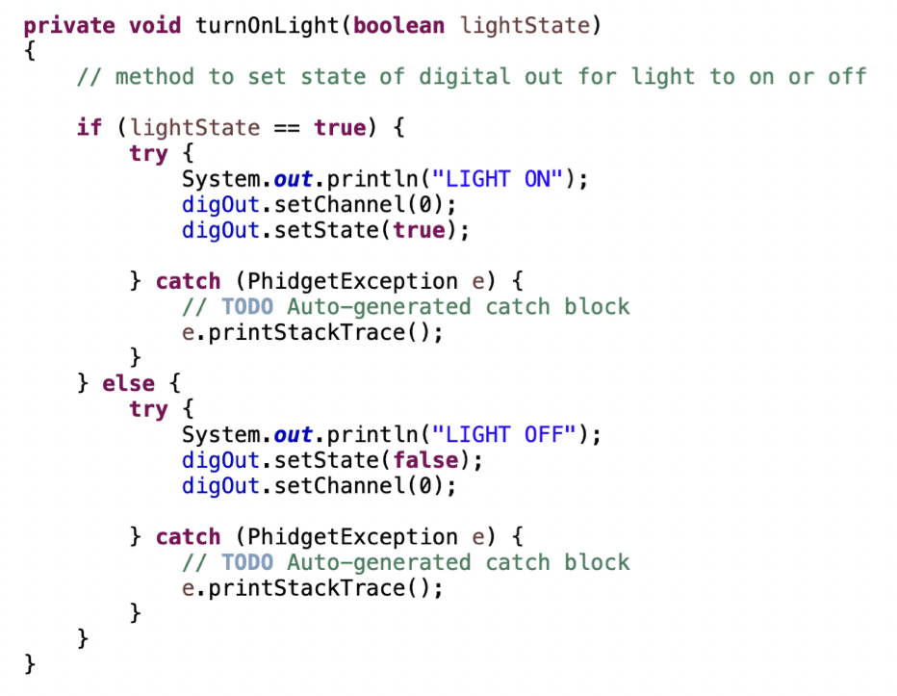
IMPLEMENTATION
+

Slide 7
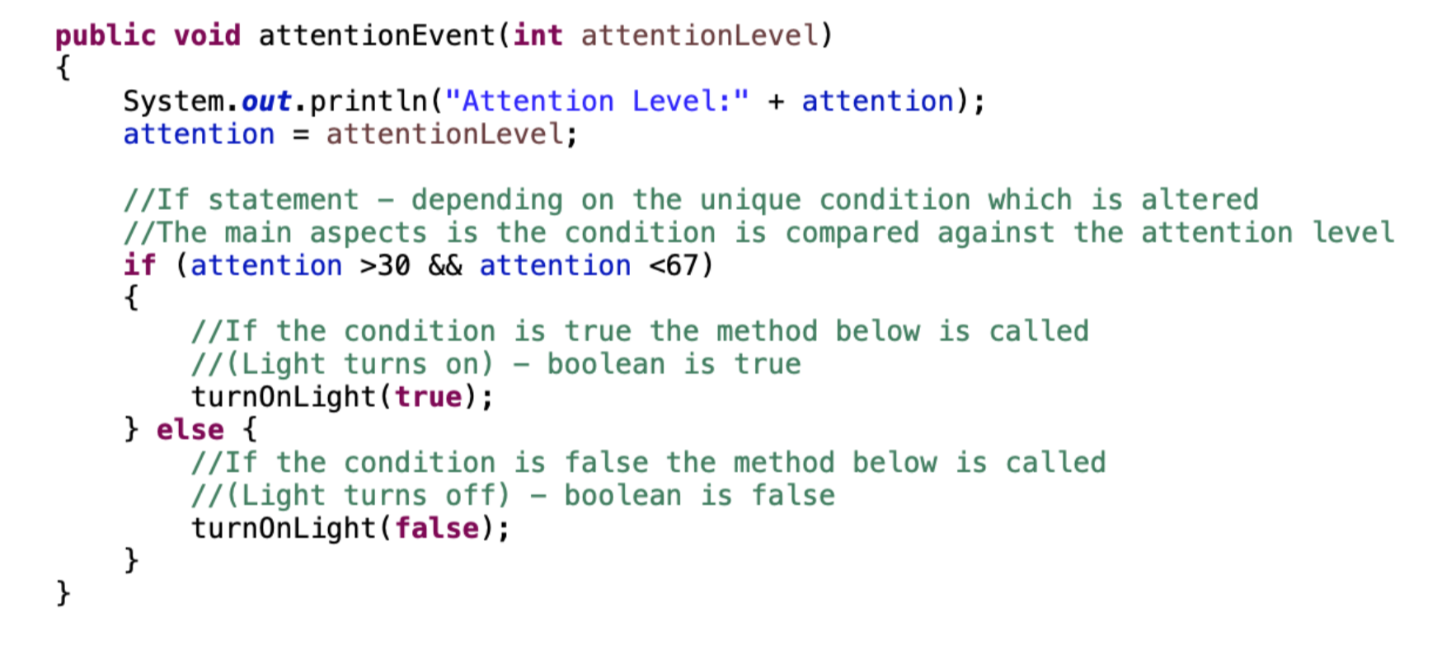

Slide 8
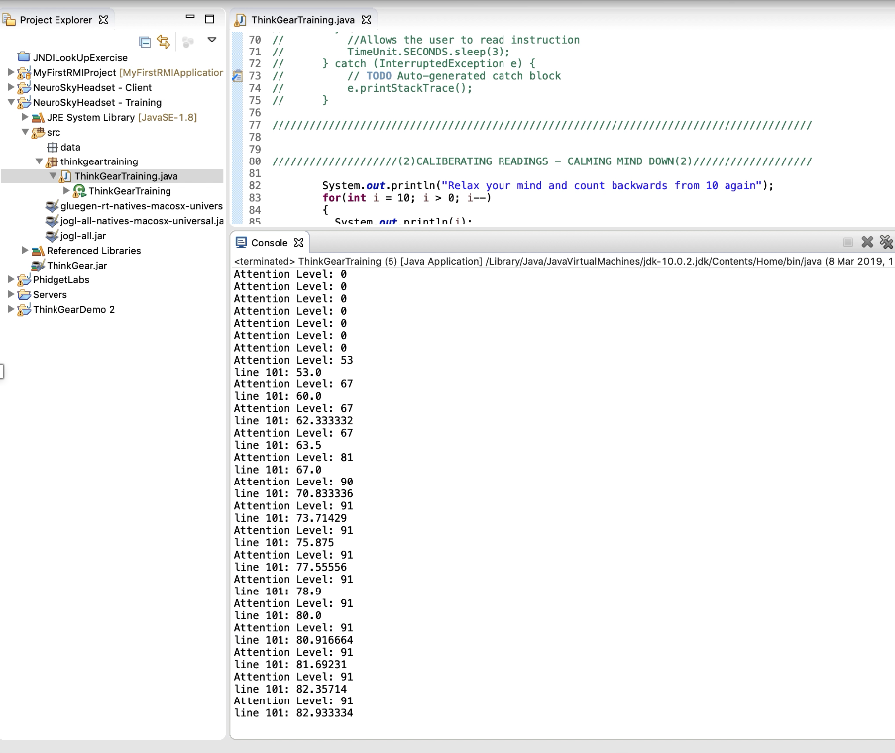
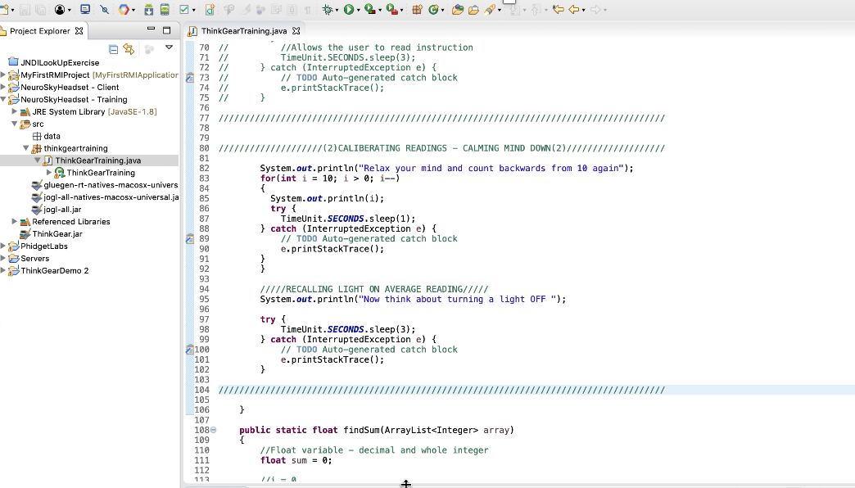
Training program
Black box testing allowed flaws to show in the existing system
ISSUES ARRISEN
Data collected is unique to every individual
Device inconsistent – Unable to pick up on all signals the brain was sending which resulted in the numerical value being 0
Difficult concept to grasp

Slide 9
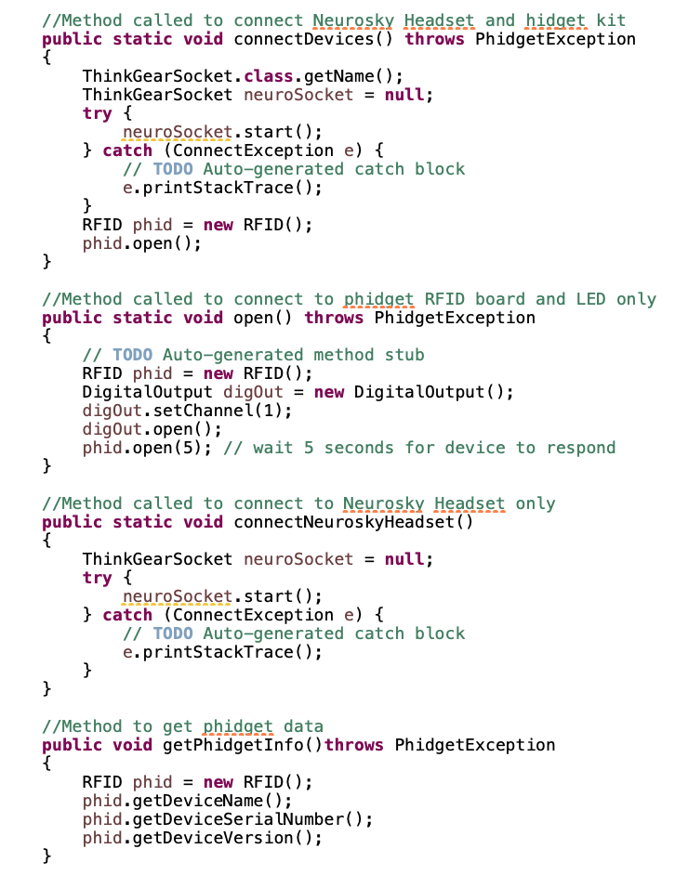
API - application programming interface
No return value
Class-based APIs (object oriented)
Includes basic syntax and primitive types.
Classes in the Java API provide strings, arrays etc
Method is visible -called from other objects (anywhere)
Method associated with class - Static method can then be used without creating an object of the class
Main methods for phidgets all under a method

Slide 10


DEMO

Slide 11
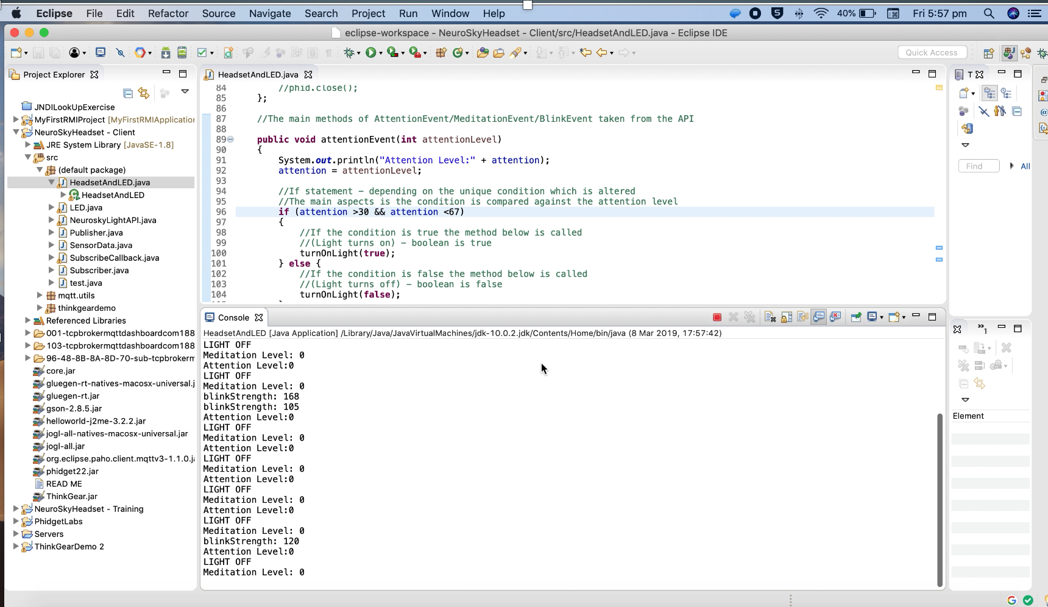

Slide 12
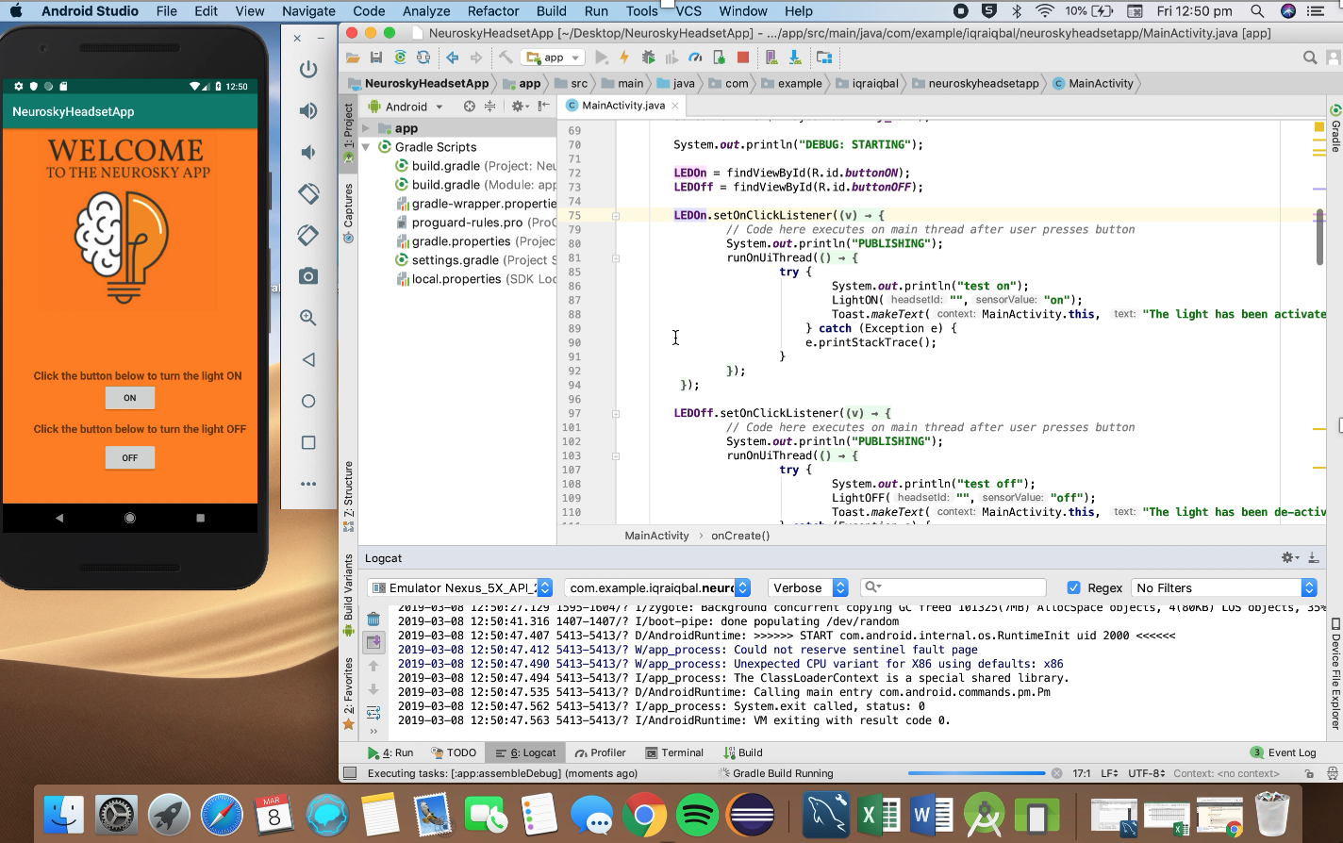
Mobile application

Slide 13
TESTING

Slide 14
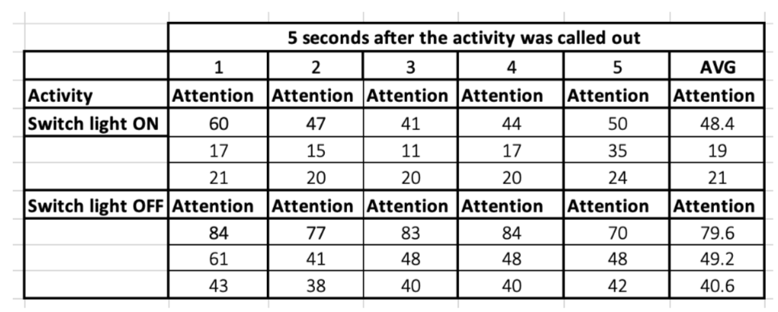
BLACK BOX TESTING
TEST SOFTWARE, BY NOT INFORMING THE SUBJECT ABOUT ANY OF THE SYSTEMS STRUCTURE

Slide 15
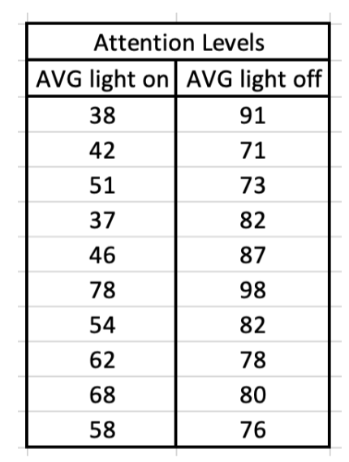
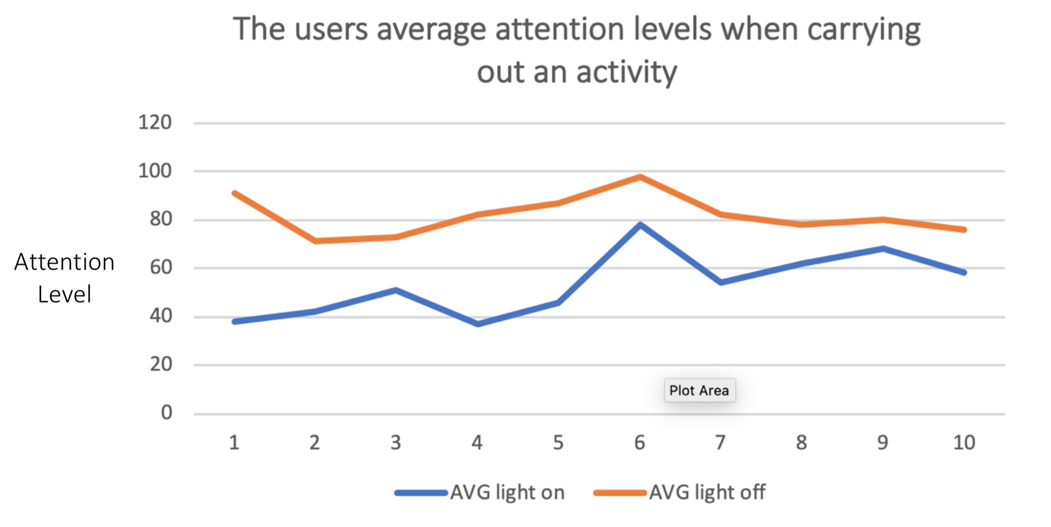
WHITE BOX TESTING
SYSTEM IS TESTED AND CHECKED BY SOMEONE WHO UNDERSTANDS ALL ASPECTS OF THE PROJECT
TRAINING SYSYEM HELPED REGULATE THE DATA MORE

Slide 16
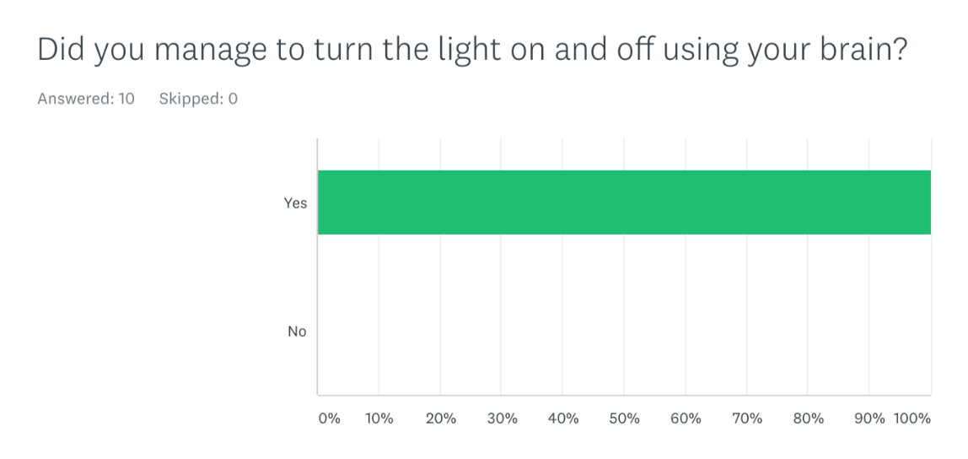
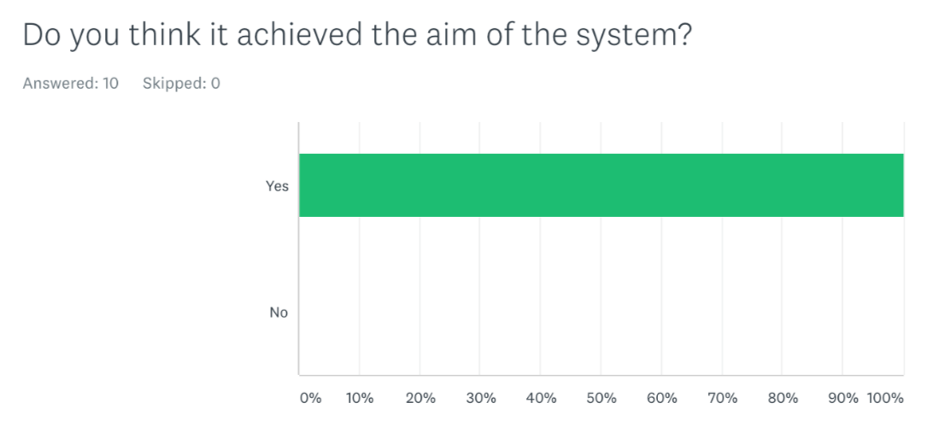
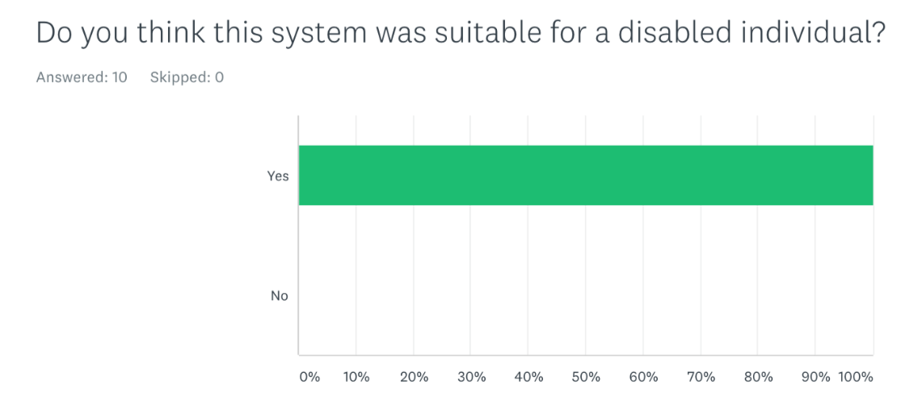
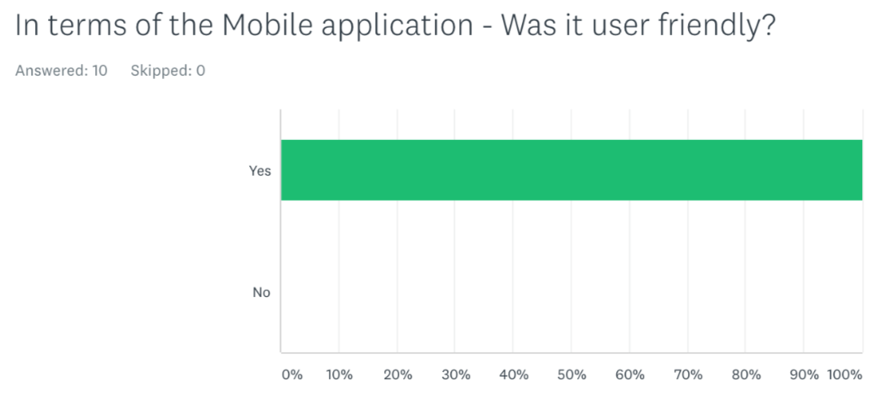
QUESTIONNAIRE
Collect important data very quickly
Wide range of people can answer the questionnaire
Results can be analysed and interpreted much
Participants used for testing included a range of people
PURPOSE SUITABLE TARGET AUDIENCE USER FRIENDLY

Slide 17


CONCLUSION
STRENGTH | WEAKNESS
FEEDBACK WAS POSITIVE | NEUROSKY HEADSET IS NOT RELIABLE OR ACCURATE
TRAINING PROGRAMME IMPLEMENTED | HEADSET LIMITED IN RANGE (BLUETOOTH) BATTERIES NEEDED (EVERY 3 HOURS)
ADEQUATE TESTING DONE Results extrapolated and generalised | TRAINING PROGRAMME FAILS TO IMPLEMENT ATTENTION LEVEL VALUE INTO THE MAIN SYSTEM AUTOMATICALLY
UNIQUE – Non existing systems in the market | THE API COULD PROVIDE MORE METHODS FOR THE DEVELOPERS TO USE

Slide 18
WHAT WOULD I DO DIFFERENTLY?
USE A DIFFERENT HEAD SET
ENHANCED DETAILED API
TESTING STAGE DONE EARLIER ON

Slide 19
What's next?
IMPLEMENT TRAINING SYSTEM WITH MAIN SYSTEM - Use a configuration file
RESEARCH INTO A BETTER HEADSET
INCORPORATE MULTIPLE LIGHT SENSORS
ADD A LOG IN FEATURE ON THE APP TO INCREASE SECURITY

Slide 20
ANY QUESTIONS?

